Slide 1
Enhancing Wellbeing: The Advantages of a Therapy and Health Web Application

Slide 2


Introduction
Welcome to the presentation on Enhancing Wellbeing through a Therapy and Health Web Application. This application offers a range of tools and resources aimed at promoting mental and physical health. Join us as we explore the advantages of this innovative platform.

Slide 3
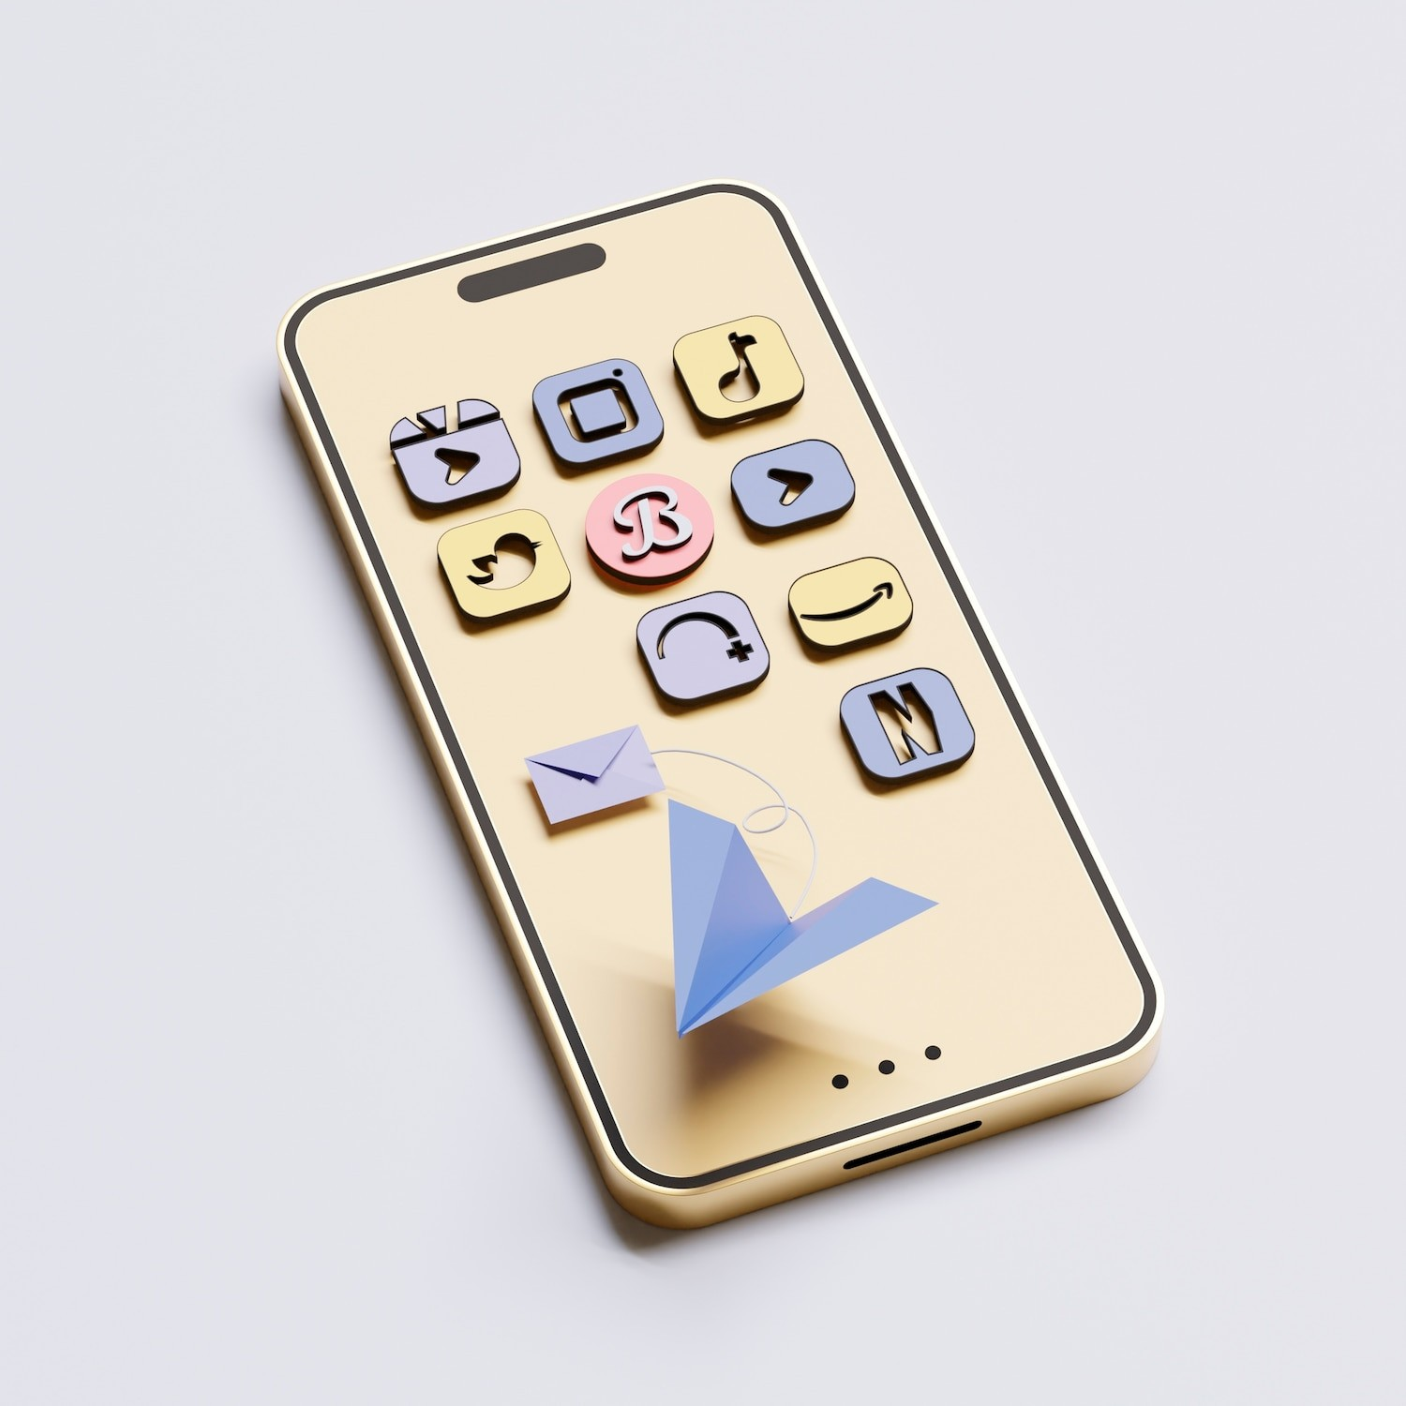
Wellness Tools
The Therapy and Health Web Application provides a variety of tools such as guided meditation, mood tracking, and stress reduction techniques. These tools aim to empower users to take control of their mental and physical health.

Slide 4

Therapy Sessions
Users can access virtual therapy sessions with licensed professionals through the Therapy and Wellness Web Application.
This feature offers convenience and accessibility, making mental health support more readily available to those in need.

Slide 5
The application fosters a sense of community by providing online support groups and forums. Users can connect with others who share similar experiences, offering a sense of belonging and understanding.

Slide 6
Through data analysis and user input, the application offers personalized recommendations for wellness activities and resources. This tailored approach enhances user engagement and promotes positive lifestyle changes.

Slide 7


Remote Accessibility
The Therapy and Wellness Web Application can be accessed remotely, allowing users to engage with the platform from the comfort of their own homes. This accessibility is especially beneﬁcial for individuals with mobility or transportation limitations.

Slide 8


Data Privacy
The application prioritizes data privacy and conﬁdentiality, ensuring that user information is securely protected. This commitment to privacy fosters trust and encourages users to engage with the platform without reservation.

Slide 9


Measurable Progress
Users can track their progress and monitor their wellbeing metrics through the application. This feature provides valuable insights and motivates individuals to continue their wellness journey.

Slide 10

Future Developments
The Therapy and Health Web Application is committed to continuous improvement and innovation. Future developments will focus on expanding the range of wellness resources and enhancing user experience.

Slide 11


Conclusion
In conclusion, the Therapy and Health Web Application offers a comprehensive approach to enhancing wellbeing. By providing tools, support, and personalized resources, this platform empowers individuals to prioritize their mental and physical health. Thank you for your attention.

Slide 12
Thanks!
Pranav Anand->E22CSEU1489 Saurav Singh->E22CSEU1479 Parshant->E22CSEU1470

